Slide 1

ML Based Stock Prediction
Submitted By
VATSAL SINGH 19104006
SHUBHANGI TRIPATHI 19104067
PUSHKAR TELAVANE 19104011
Under The Guidance Of
Prof. Apeksha Mohite
Prof. Sneha Dalvi

Slide 2
Contents
Introduction
Objectives
Scope
Features / Functionality
Project Outcomes
Technology Stack
Block Diagram if applicable

Slide 3
1. Introduction
The share market is a place where the shares of a public company are traded. As discussed in the volatile nature of the stock market makes it an area which needs an abundance of analysis with the old data predicated.
The previous stock trend prediction algorithms use the historic time series stock data. the typical scientific stock price forecasting procedures are focused on the statistical analysis of stock data. In the paper will develop a stock data predictor program that uses previous stock prices and data will be treated as training sets for the program to predict the stock prices of a particular share this program develops a procedure.

Slide 4
2. Objectives
To predict the stock price such that he/she can sell it before its value decline or buy the stock before the price rises.
To determine the future movement of the stock value of a financial exchange.
To predict the price of the share in the stock using recent/previous timeline data.

Slide 5
3. Scope
The choice of machine learning model has been based in previous research where the LSTM architecture has proven effective in prediction with regards to financial time series data.
The main aim is to build an application in such a way that it will provide a platform where a stock price prediction of all the companies under BSE&NSE will be displayed.
This website comparatively analyzes the effectiveness of prediction algorithms on stock price prediction and get general insight on this data through visualization to predict future stock behavior and value at risk for each stock.
This website will use LSTM method to predict future stock returns based on past.

Slide 6
4. Feature /Functionality
Latest Updates on Prices of Stocks:
Our website basically provides the latest Updates on prices of BSE and NSE which help the users to stay up to date.
History of Stocks records:
There are many sites to get historical stock prices but accessing them may be a bit more difficult. So, we have decided to provide a website which keep all the record perfectly managed.
Multiple Stocks to Study:
The purpose of our framework is to analyze which is the best time span to predict the future share price of a company from a particular sector.
Graphical Stats :
The graphical charts makes easier to predict the future prices. Rather than from the heap of numerical stock prices.

Slide 7
5. Outcome of Project
The movement in the stock market is usually determined by the sentiments of thousands of investors. Stock market prediction, calls for an ability to predict the effect of recent events on the investors.
• The Opening Value of the stock, the Highest and Lowest values of that stock on the same days, as well as the Closing Value at the end of the day, are all indicated for each date through scrapping.
• Predicting the stock market was a time-consuming and laborious procedure a few years or even a decade ago.
• However, with the application of LSTM for stock price prediction forecasts, the procedure has become much simpler.
• It is beyond the scope of almost all investors to correctly and consistently predict these hyper parameters. All these factors make stock price prediction very difficult. Once the right data is collected, it then can be used to train a machine and to generate a predictive result

Slide 8
6. Technology Stack
Hardware Requirements:
Processor: Intel Core 4 or above
RAM: 4GB or above
Software Requirements:
Backend: Jupyter/colab/Dataset
JupyterLab is the latest web-based interactive development environment for notebooks, code, and data. Its flexible interface allows users to configure and arrange workflows in data science, scientific computing, computational journalism, and machine learning. A modular design invites extensions to expand and enrich functionality. Yfinance is used as Dataset.
Front end: Streamlit
Streamlit is a free and open-source framework to rapidly build and share beautiful machine learning and data science web apps. It is a Python-based library specifically designed for machine learning engineers.

Slide 9
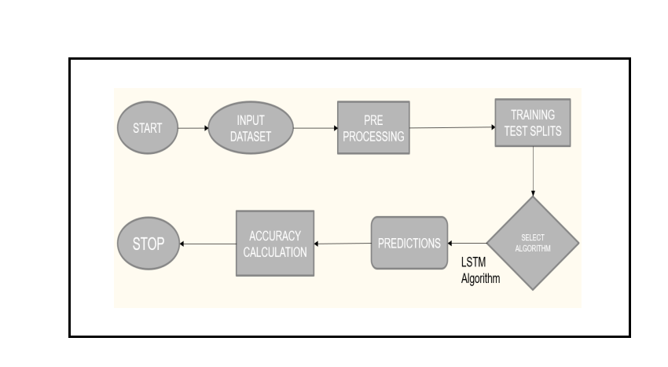
7. Block Diagram
Figure 1: Project Architecture
The data from the dataset is acquired by the model by splitting the data in certain percentage for training and testing purpose and predictive model is made using prediction algorithm, then make the prediction using different dataset for the accuracy of the predictive model and evaluate the accuracy of the model prediction for the required stock

Slide 10
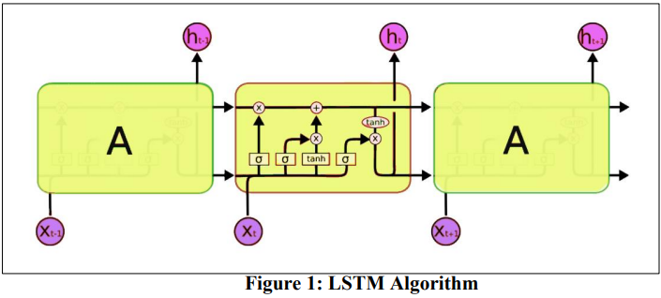
LSTM
LSTM follow this chain-like structure, however the repeating module has a different structure. Instead of having a single neural network layer, there are four layers, interacting in a very special way as shown
Purpose:
•The proposed algorithm using the market data to predict the share price using machine learning techniques like recurrent neural network named as Long Short-Term Memory (LSTM).
•This system will provide accurate outcomes in comparison to currently available stock price predictor algorithms.
•The network is trained and evaluated with various sizes of input data to urge the graphical outcomes.

Slide 11
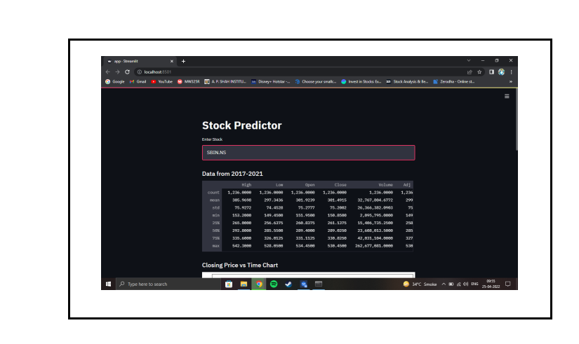
Project Implementation:
Figure 4: Stock Data Description
Dashboard Page: A dashboard is a visual representation of the most important information needed to achieve one or more goals, consolidated and arranged on a single screen so that information can be controlled at a glance.

Slide 12
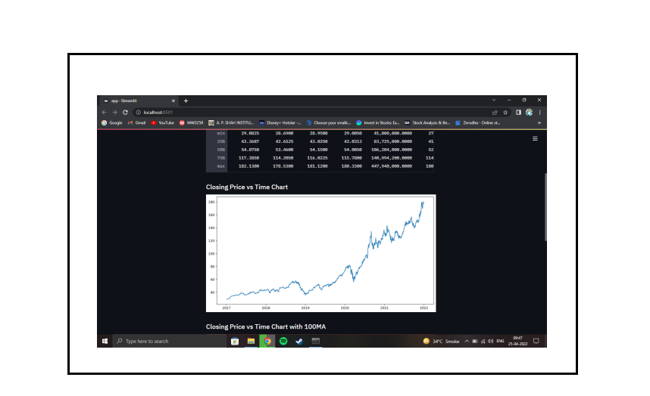
Figure 5: Closing vs Time Chart
Visualization of Graph:Graph of the data provided from start date to end date table above is represented in terms of Closing Price vs Time Chart.

Slide 13
CONCLUSION
In this project, we analyze the growth of the companies from different sector and try to find out which is the best time span for predicting the future price of the share. So, this draws an important conclusion that companies from a certain sector have the same dependencies as well as the same growth rate. The prediction can be more accurate if the model will train with a greater number of data set. Moreover, in the case of prediction of various shares, there may be some scope of specific business analysis. We can study the different pattern of the share price of different sectors and can analyze a graph with more different time span to fine tune the accuracy. This framework broadly helps in market analysis and prediction of growth of different companies in different time spans. Incorporating other parameters (e.g., investor sentiment, election outcome, geopolitical stability) that are not directly correlated with the closing price may improve the prediction accuracy. The study indicates that varying time steps on this particular LSTM model does not impact the predictive powers of the model to a large extent, however 10-time steps seem to be the optimal amount of time steps among the different settings used in this model.

Slide 14
Thank You...!!

